Slide 1
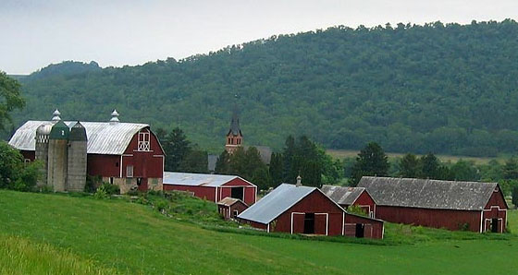


Dairy Subtitle of the 2014 Agricultural Act
Mark Stephenson
Director of Dairy Policy Analysis

Slide 2

We Made It!
Congress didn’t make it easy, but on February 7th, President Obama signed the Agricultural Act of 2014 into law.

Slide 3
Things that Go Away
Repeals the dairy export incentive program
Repeals the dairy product price support program
Repeals the MILC program after the margin protection program is operational
  MILC has paid significant dollars to producers
  MILC was an easy program in which to participate
    Picking correct start month was probably the hardest part for large farms
    Larger farms were not a fan of the program

Slide 4
Things that Stay
Dairy Price Support Program (the old one—permanent legislation—of “Dairy Cliff” fame)
Extends the dairy forward pricing program
Livestock Gross Margin for Dairy
Language that would allow the formation of a California Federal Milk Marketing Order with consideration of their quota program.

Slide 5
Things that Are New
Creates a margin protection program (MPP)
  Run by the Farm Service Agency
  Farms can choose the MPP or LGM-D, but cannot use both (this is a one-time decision)
Creates a dairy product donation program

Slide 6
What is this Margin?
All Milk Price less Feed Cost
  The average cost of feed for a dairy operation required to produce a cwt of milk, determined in accordance with the following formula:
  Milk, corn and alfalfa prices reported by NASS in Agricultural Prices; soybean meal price is Central Illinois, USDA/AMS
Formula was developed by NMPF and used in the Dairy Security Act. Meant to feed cow at average production for 100 lbs of milk with complement of youngstock, dry cows and sick animals. Values reduced to 90% of full needs by Senate.
[1.0728 X $ corn/bu] + [0.00735 X $ SBM/ton] + [0.0137 X $ alfalfa hay/ton]

Slide 7
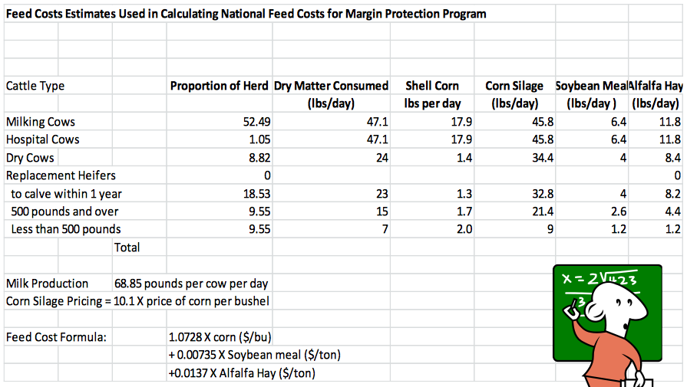
The Ration

Slide 8
What is this Margin?
This measure of IOFC has as averaged about $8.50

Slide 9
How Does It Compare?
This measure of IOFC has as averaged about $8.50

Slide 10
What is this Margin?
The margin values will be averaged in two-month pairs of Jan-Feb, Mar-Apr, May-Jun, Jul-Aug, Sep-Oct, Nov-Dec
The margin level will determine indemnity payments
This is a national measure of dairy farm well-being—your actual mileage will vary.

Slide 11
Annual Decision
The MPP is an insurance product—you pay a premium and you will receive an indemnity payment if due
You already have a production history
  Highest annual production in 2011, 2012 or 2013
  Your production history will be increased by national average rate of growth in milk production
Annual choice of coverage percentage between 25% and 90% in 5% increments
Annual choice of coverage level between $4 and $8 in 50¢ increments

Slide 12
Premium Rates
Premiums at 2 rate levels: first 4 million pounds and above 4 million pounds
Premiums increase in cost as you increase margin level.
Much more expensive above $6.50
Also a $100 annual fee

Slide 13
Premium Rates
Premium rates are fixed over the life of the farm bill
Premium rates are heavily subsidized

Slide 14
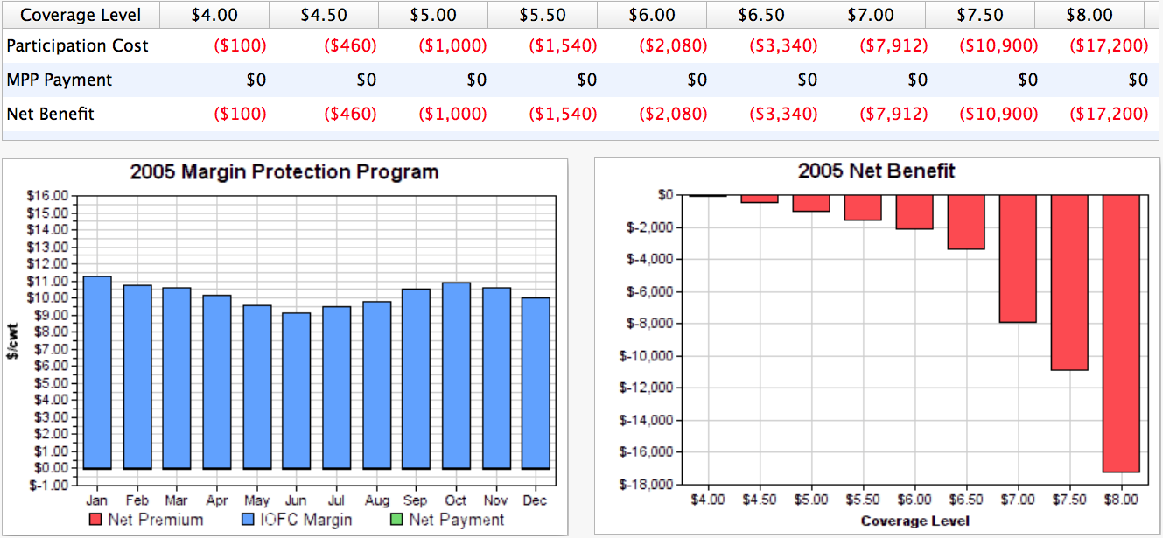
Let’s Look Back in Time
2005
175 Cows, producing 23,000 lbs of milk per cow, or 4 million annual production history

Slide 15
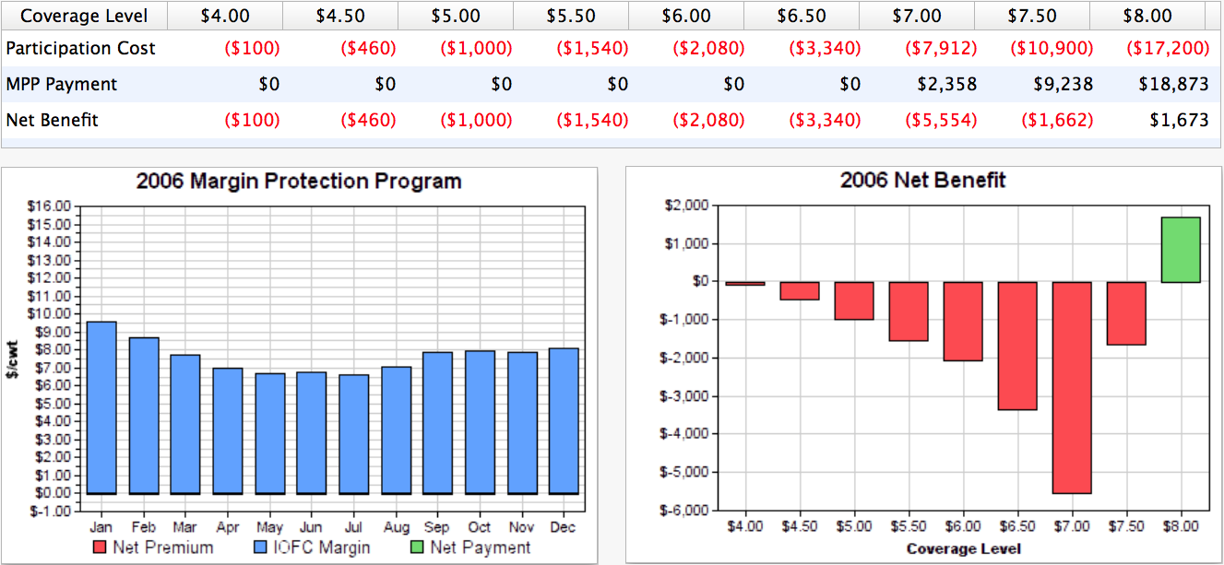
Let’s Look Back in Time
2006
175 Cows, producing 23,000 lbs of milk per cow, or 4 million annual production history

Slide 16
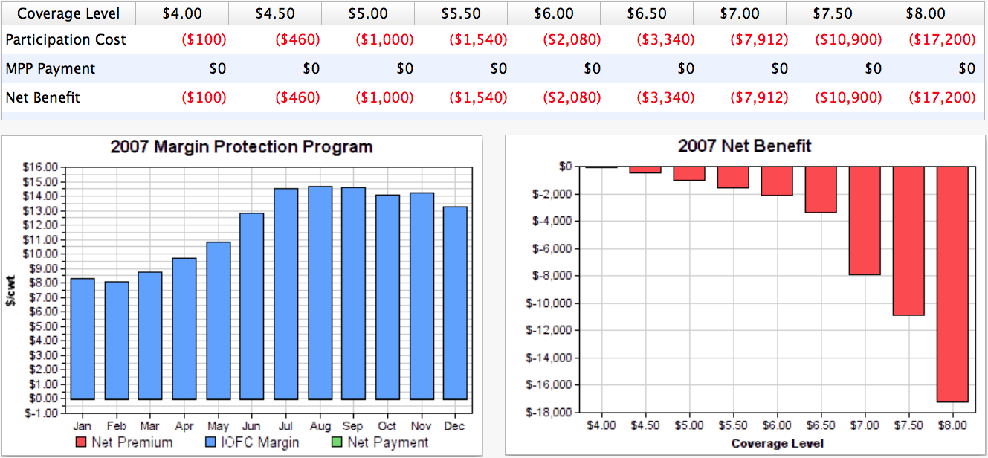
Let’s Look Back in Time
2007
175 Cows, producing 23,000 lbs of milk per cow, or 4 million annual production history

Slide 17
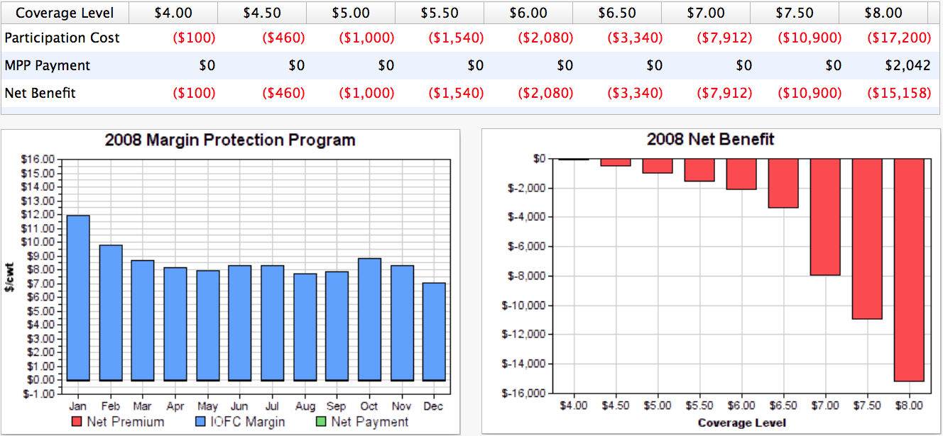
Let’s Look Back in Time
2008
175 Cows, producing 23,000 lbs of milk per cow, or 4 million annual production history

Slide 18
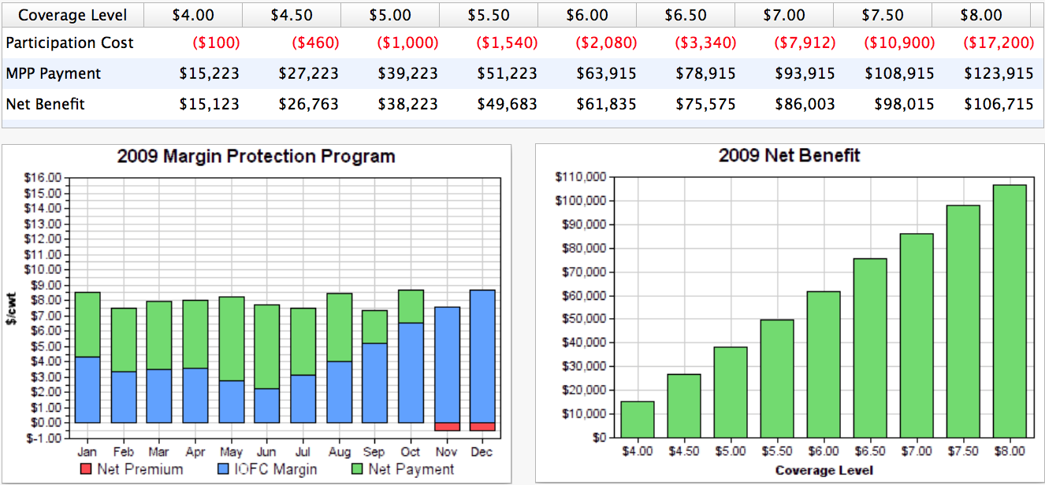
Let’s Look Back in Time
2009
175 Cows, producing 23,000 lbs of milk per cow, or 4 million annual production history
MILC paid this farm $44,800 that year.

Slide 19
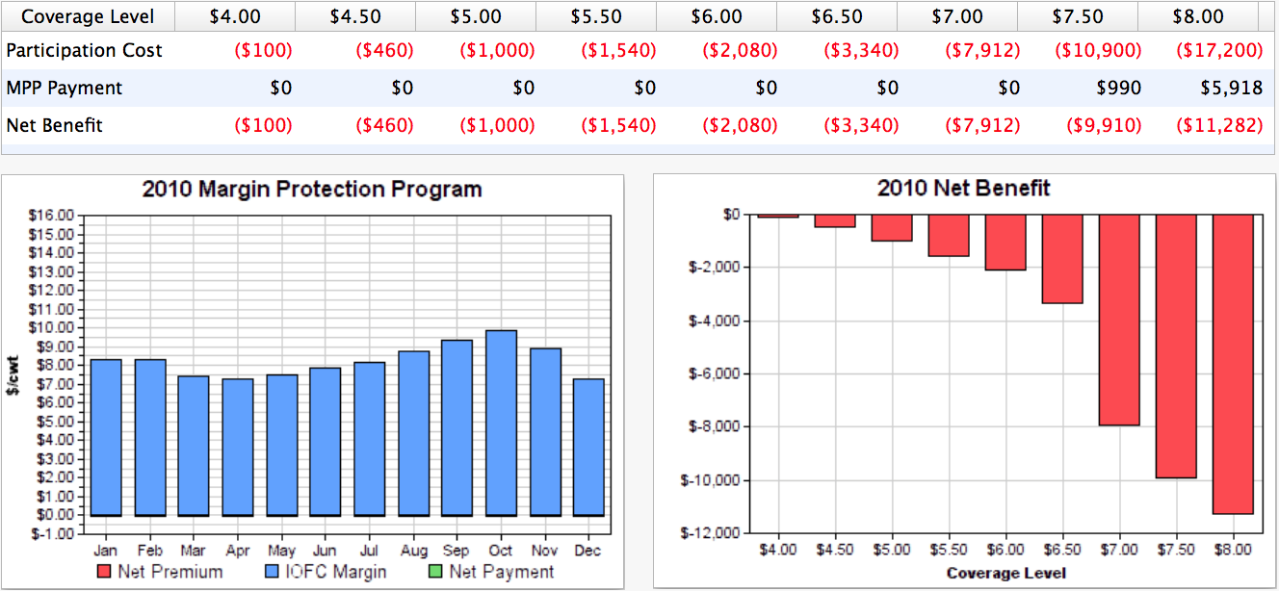
Let’s Look Back in Time
2010
175 Cows, producing 23,000 lbs of milk per cow, or 4 million annual production history

Slide 20
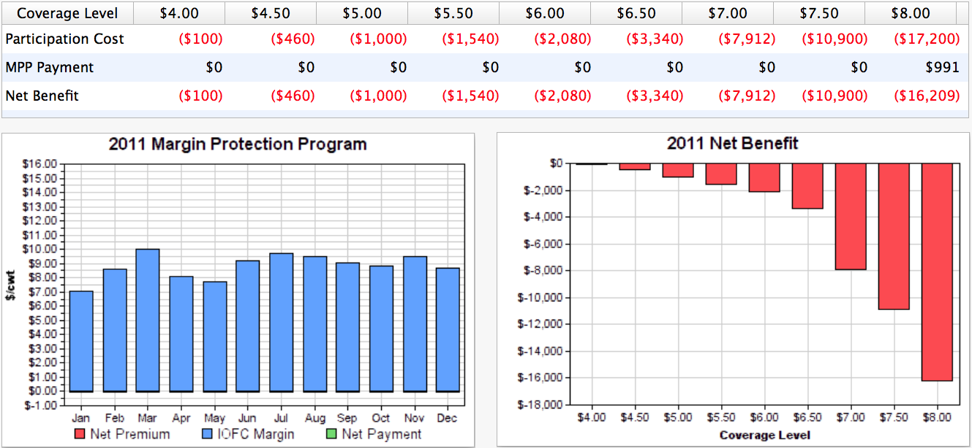
Let’s Look Back in Time
2011
175 Cows, producing 23,000 lbs of milk per cow, or 4 million annual production history

Slide 21
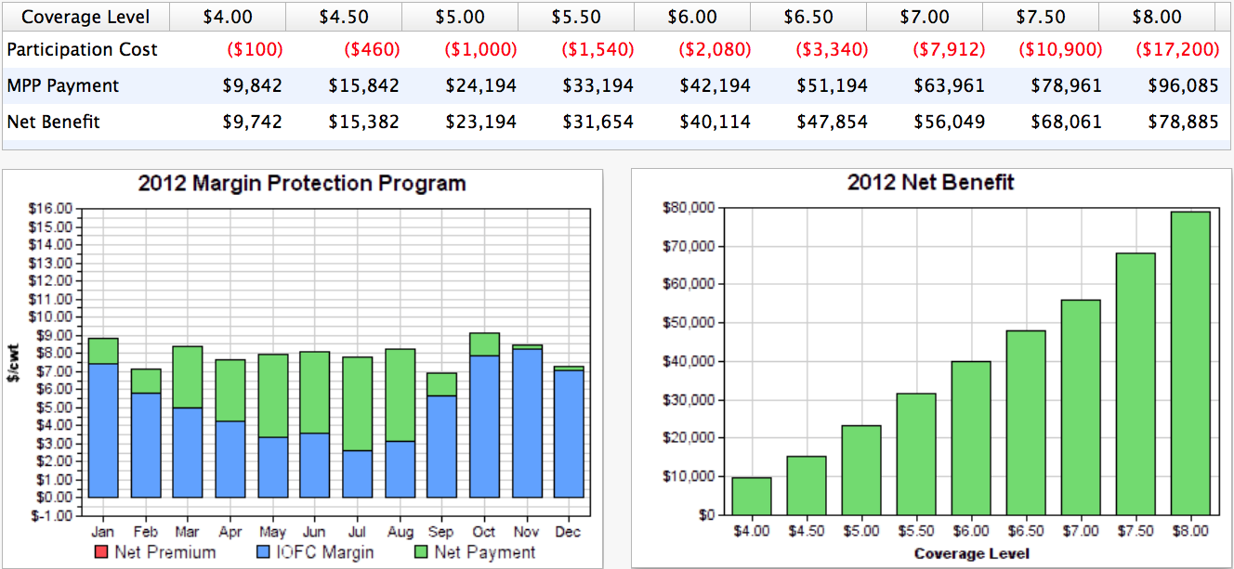
Let’s Look Back in Time
2012
175 Cows, producing 23,000 lbs of milk per cow, or 4 million annual production history
MILC paid this farm $29,000 that year.

Slide 22
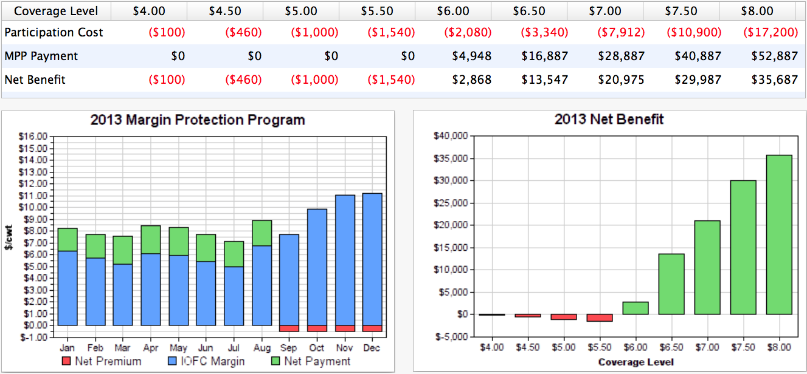
Let’s Look Back in Time
2013
175 Cows, producing 23,000 lbs of milk per cow, or 4 million annual production history
MILC paid this farm $10,300 that year.

Slide 23
If We Picked the Optimal Strategy
Year | Optimal Strategy | Optimal Outcome
2005 | $4.00 | -$100
2006 | $8.00 | $1,673
2007 | $4.00 | -$100
2008 | $4.00 | -$100
2009 | $8.00 | $106,715
2010 | $4.00 | -$100
2011 | $4.00 | -$100
2012 | $8.00 | $78,885
2013 | $8.00 | $35,687
2014 | $4.00 | -$100
 | Total | $224,137
 | per cow | $128.08
 | per cwt | $0.56

Slide 24
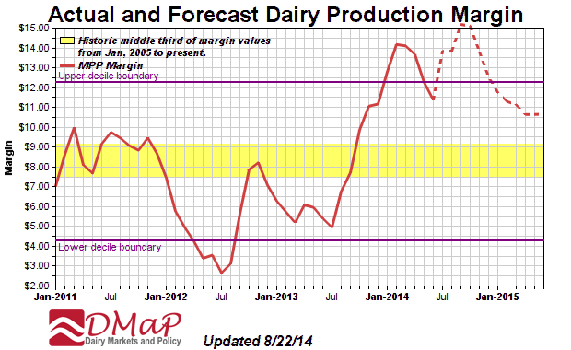
We Aren’t Clueless

Slide 25


Slide 26
If We Picked Advanced Strategy
Year | Advance Strategy | Advance Outcome
2005 | $4.00 | -$100
2006 | $4.00 | -$100
2007 | $6.00 | -$2,080
2008 | $6.00 | -$2,080
2009 | $8.00 | $106,715
2010 | $4.00 | -$100
2011 | $8.00 | -$16,209
2012 | $6.50 | $48,004
2013 | $6.50 | $14,930
2014 | $4.00 | -$100
 | Total | $148,880
 | per cow | $85.07
 | per cwt | $0.37

Slide 27
If We Picked Risk Strategy
Year | Risk Strategy | Risk Outcome
2005 | $6.50 | ($3,340)
2006 | $6.50 | ($3,340)
2007 | $6.50 | ($3,340)
2008 | $6.50 | ($3,340)
2009 | $6.50 | $75,574
2010 | $6.50 | ($3,340)
2011 | $6.50 | ($3,340)
2012 | $6.50 | $48,004
2013 | $6.50 | $14,930
2014 | $6.50 | ($3,340)
 | Total | $115,128
 | per cow | $65.79
 | per cwt | $0.29

Slide 28
Dairy Product Donation Program
Must be operational no later than 120 days after the margin program begins
When the margin is less than $4.00 for the two preceding months, this feature becomes operational
Secretary purchases dairy products at prevailing market prices and distributes to public and private nonprofits assisting low-income households. Cannot hold/store purchases.
This program suspended:
  After three months of operation
  Margins move above $4.00
  Margins between $3.00 & $4.00 AND U.S. prices exceed world prices by more than 5%
  Margins less than $3.00 AND U.S. prices exceed world prices by more than 7%
Program will shorten low margin periods but cost more than paying indemnities

Slide 29
Observations…
Program will support larger dairies much better than MILC did
Program will require some decisions and some “skin in the game”
It will reduce income risk
Less risk will produce more milk in the long-run

Slide 30
Conclusions…
Need to think about:
  Your risk-bearing ability (high versus low leverage)
  Your risk preferences (love the thrill, or can’t sleep at night)
  Am I a small farm or a larger farm (cost of premiums makes a difference)
Do you need other forms of coverage:
  LGM-Dairy vs MPP-Dairy
  MPP-Dairy plus forward contracts or futures
MPP-Dairy will be a very helpful tool, but it’s no substitute for good management

Slide 31
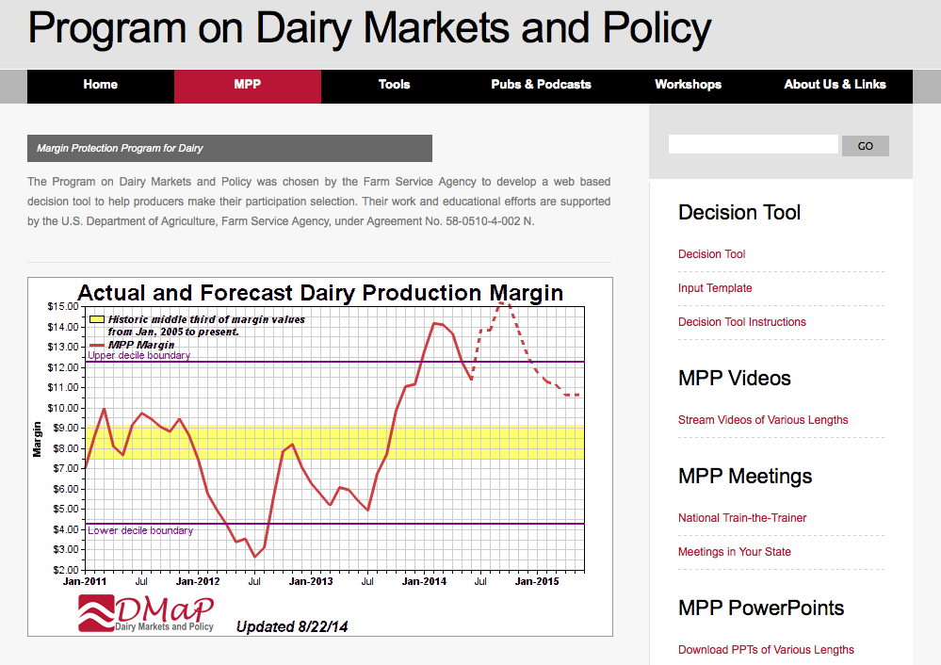
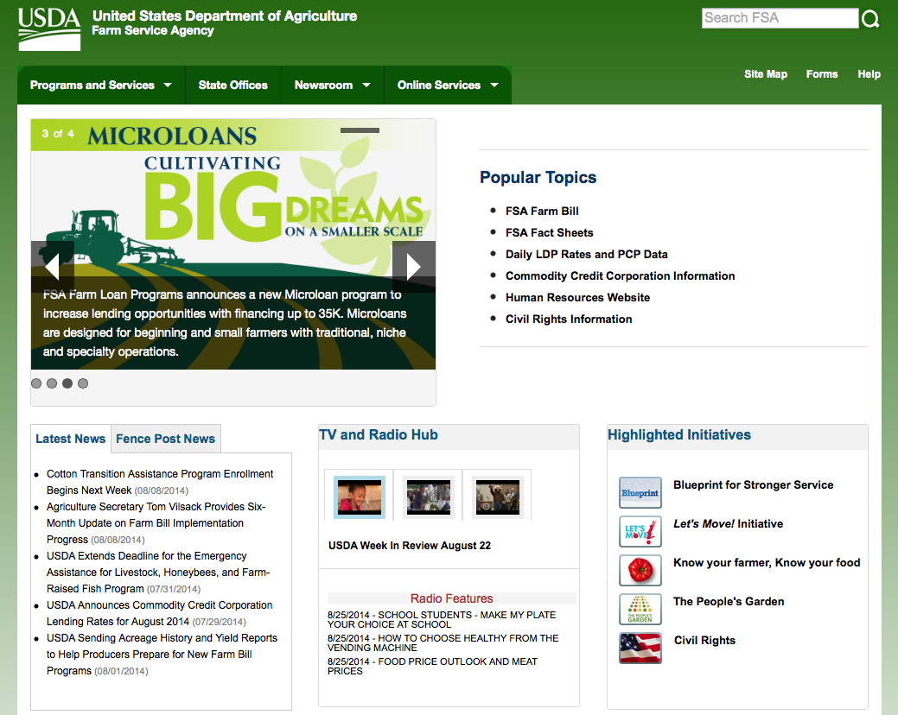
For More Information
http://DairyMarkets.org
http://FSA.USDA.gov

